Slide 1
Deep Dive into OOPS
Classes ,Object & Constructors

Slide 2
Let’s recall - OOPS
Object-oriented programming – As the name suggests uses objects in programming.
Object-oriented programming aims to implement real-world entities like inheritance, hiding, polymorphism, etc in programming.
The main aim of OOP is to bind together the data and the functions that operate on them so that no other part of the code can access this data except that function.

Slide 3
Class
The building block of C++ that leads to Object-Oriented programming is a Class.
It is a user-defined data type, which holds its own data members and member functions, which can be accessed and used by creating an instance of that class.
A class is like a blueprint for an object.
you first must define its general form by using the keyword class. A class is similar syntactically to a structure.A class declaration defines a new type that links code and data.

Slide 4
Characteristics of classes
By default, all items defined in a class are private.
To make parts of a class public (that is, accessible to other parts of your program),you must declare them after the public keyword.
Example: In real life, a car is an object.
The car has attributes, such as weight and color, and
methods, such as drive and brake.
Attributes and methods are basically variables and functions that belongs to the class. These are often referred to as "class members".
Example/.

Slide 5
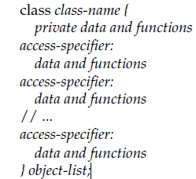
Access Specifiers
The object-list is optional. If present, it declares objects of the class. Here,
access-specifier is one of these three C++ keywords:
public
private
protected

Slide 6



Structures and Classes Are Related
Structures are part of the C subset and were inherited from the C language.
As you have seen, a class is syntactically similar to a struct.
In C++, the role of the structure was expanded, making it an alternative way to specify a class. In fact, the only difference between a class and a struct is that by default all members are public in a struct and private in a class.

Slide 7
Is it possible to grant permission for a class to access the private members of another?
Friend Classes
It is possible for one class to be a friend of another class.
When this is the case, the friend class and all of its member functions have access to the private members defined within the other class.
Example./

Slide 8
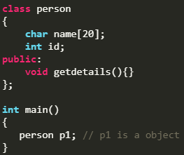
Object
An Object is an identifiable entity with some characteristics and behaviour.
An Object is an instance of a Class. When a class is defined, no memory is allocated but when it is instantiated (i.e. an object is created) memory is allocated.
Multiple Objects
You can create multiple objects of one class:
Example./

Slide 9
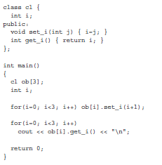
Array of Objects
The syntax for declaring and using an object array is exactly the same as it is for any other type of array. For example, this program uses a three-element array of objects:

Slide 10
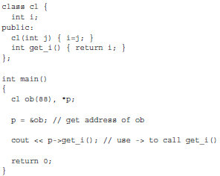
Pointers to Objects
Just as you can have pointers to other types of variables, you can have pointers to objects.
When accessing members of a class given a pointer to an object, use the arrow(–>) operator instead of the dot operator.

Slide 11
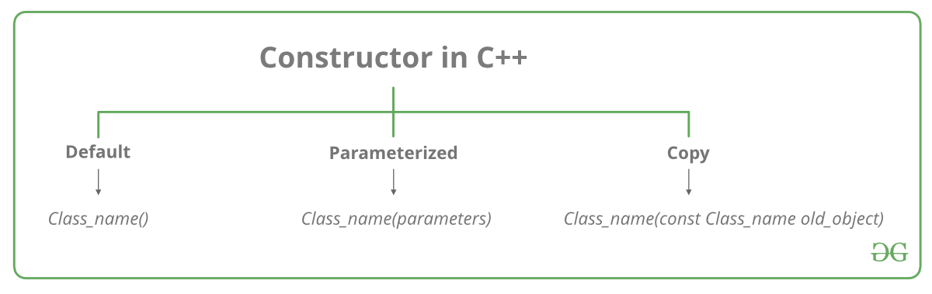
Class Constructor
A class constructor is a special member function of a class that is executed whenever we create new objects of that class.
A constructor will have exact same name as the class and it does not have any return type at all, not even void.
Constructors can be very useful for setting initial values for certain member variables.

Slide 12
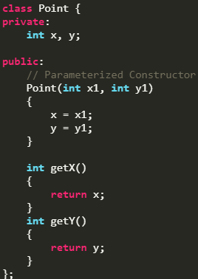
Parameterized Constructor
A default constructor does not have any parameter, but if you need, a constructor can have parameters.

Slide 13
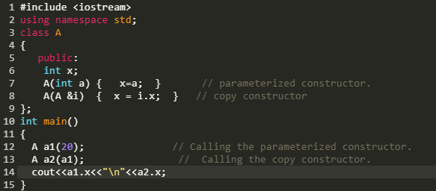
Copy Constructor
A copy constructor is a member function which initializes an object using another object of the same class.
Default Copy constructor:
The compiler defines the default copy constructor. If the user defines no copy constructor, compiler supplies its constructor.

Slide 14
Class Destructor
A destructor is used to destroy the instances.
A destructor will have exact same name as the class prefixed with a tilde (~) and it can neither return a value nor can it take any parameters.
Destructor can be very useful for releasing resources before coming out of the program like closing files, releasing memories etc.
Example./

Slide 15
THANK YOU

